Slide 1


Our Trip to London Zoo
Exploring Interdependence and Learning How to Save Our Seas
Year One | Theme: Saving the Seas

Slide 2
Harmony principle: Interdependence
Enquiry driver: How do we save the seas?
Weekly question:
What do we like about the beach?
Why is the sea important?
How am I unique?
How am I special?
What is my talent?
How do different people help the community?
Navigate characteristics:
Honesty

Slide 3
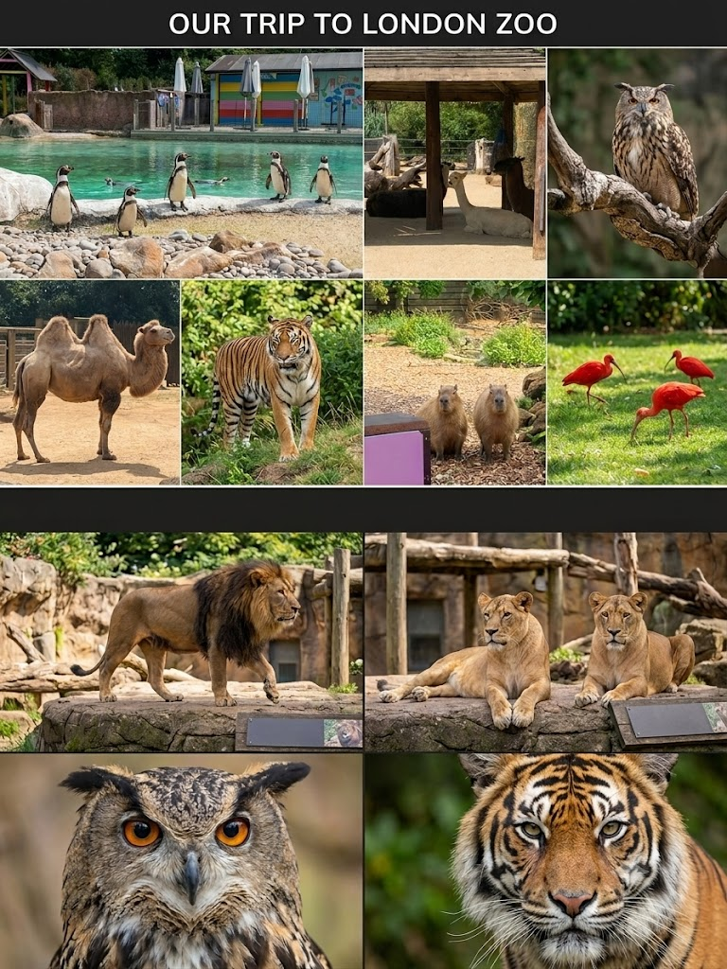
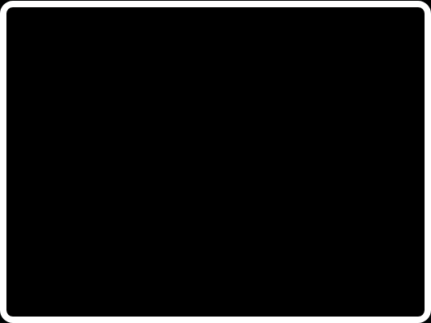


Learning Interdependence
We are all connected!
To learn more about Interdependence we visited the zoo.
We learnt that all animals depend on each other, on their keepers, and on us to survive! Just like the tigers, camels, and owls at the zoo need their habitats looked after, the ocean animals need us to protect their homes too.

Slide 4




The Beach and The Sea
What do we like about the beach?
Why is the sea important?
We love playing in the soft sand, building big sandcastles, and splashing in the cool waves!
The sea is not just water; it is a giant, amazing home for millions of wonderful creatures!
Humboldt Penguins at ZSL London Zoo love their sandy "Penguin Beach" just like we do! It's their safe space to sunbathe and nest.
The sea provides fish for penguins to eat. Penguins "fly" through the water to hunt. Without clean seas, they would have no food!

Slide 5






How Do We Save the Seas?
Say No to Plastic
Keep Beaches Clean
Reuse & Recycle
London Zoo is single-use plastic bottle free! We can save the sea by using reusable water bottles every day.
Plastic in the ocean can hurt penguins. Keeping our local beaches clean means plastic doesn't wash out to sea!
Keepers at the zoo make fun feeding puzzles out of clean recycled plastic for penguins. We can recycle our plastic too!

Slide 6


We Are Unique and Special!
How am I unique & special?
What is my special talent?
At London Zoo, every penguin has a colorful ID armband so keepers know exactly who they are!
Humboldt penguins have a spectacular talent: they can swim up to 30 miles per hour!
Just like those penguins, you are completely unique. There is only one you, and that makes you incredibly special to our classroom community!
We all have different, wonderful talents. Some of us are great at drawing, some at telling jokes, and others at being kind. What is your talent?

Slide 7


Our Community & Honesty
Helping the community
Honesty protects nature
At the zoo, zookeepers, vets, and cleaners work together to feed animals and protect nature.
Honesty means telling the truth and keeping our promises.
We can help our community by picking up litter, recycling, and reminding others to use reusable cups instead of plastic.
Let’s be honest about our plastic use! By tracking how much plastic we use, we can take real, honest steps to use less and help save our wildlife.

Slide 8

Let's Save the Seas!
"We depend on the ocean, and the ocean depends on us.
Together, we can make our world plastic-free!"
1 School community working together
to protect our penguin friends!

