Slide 1
Reception Harmony curriculum
Autumn 1 - The principle of health

Slide 2
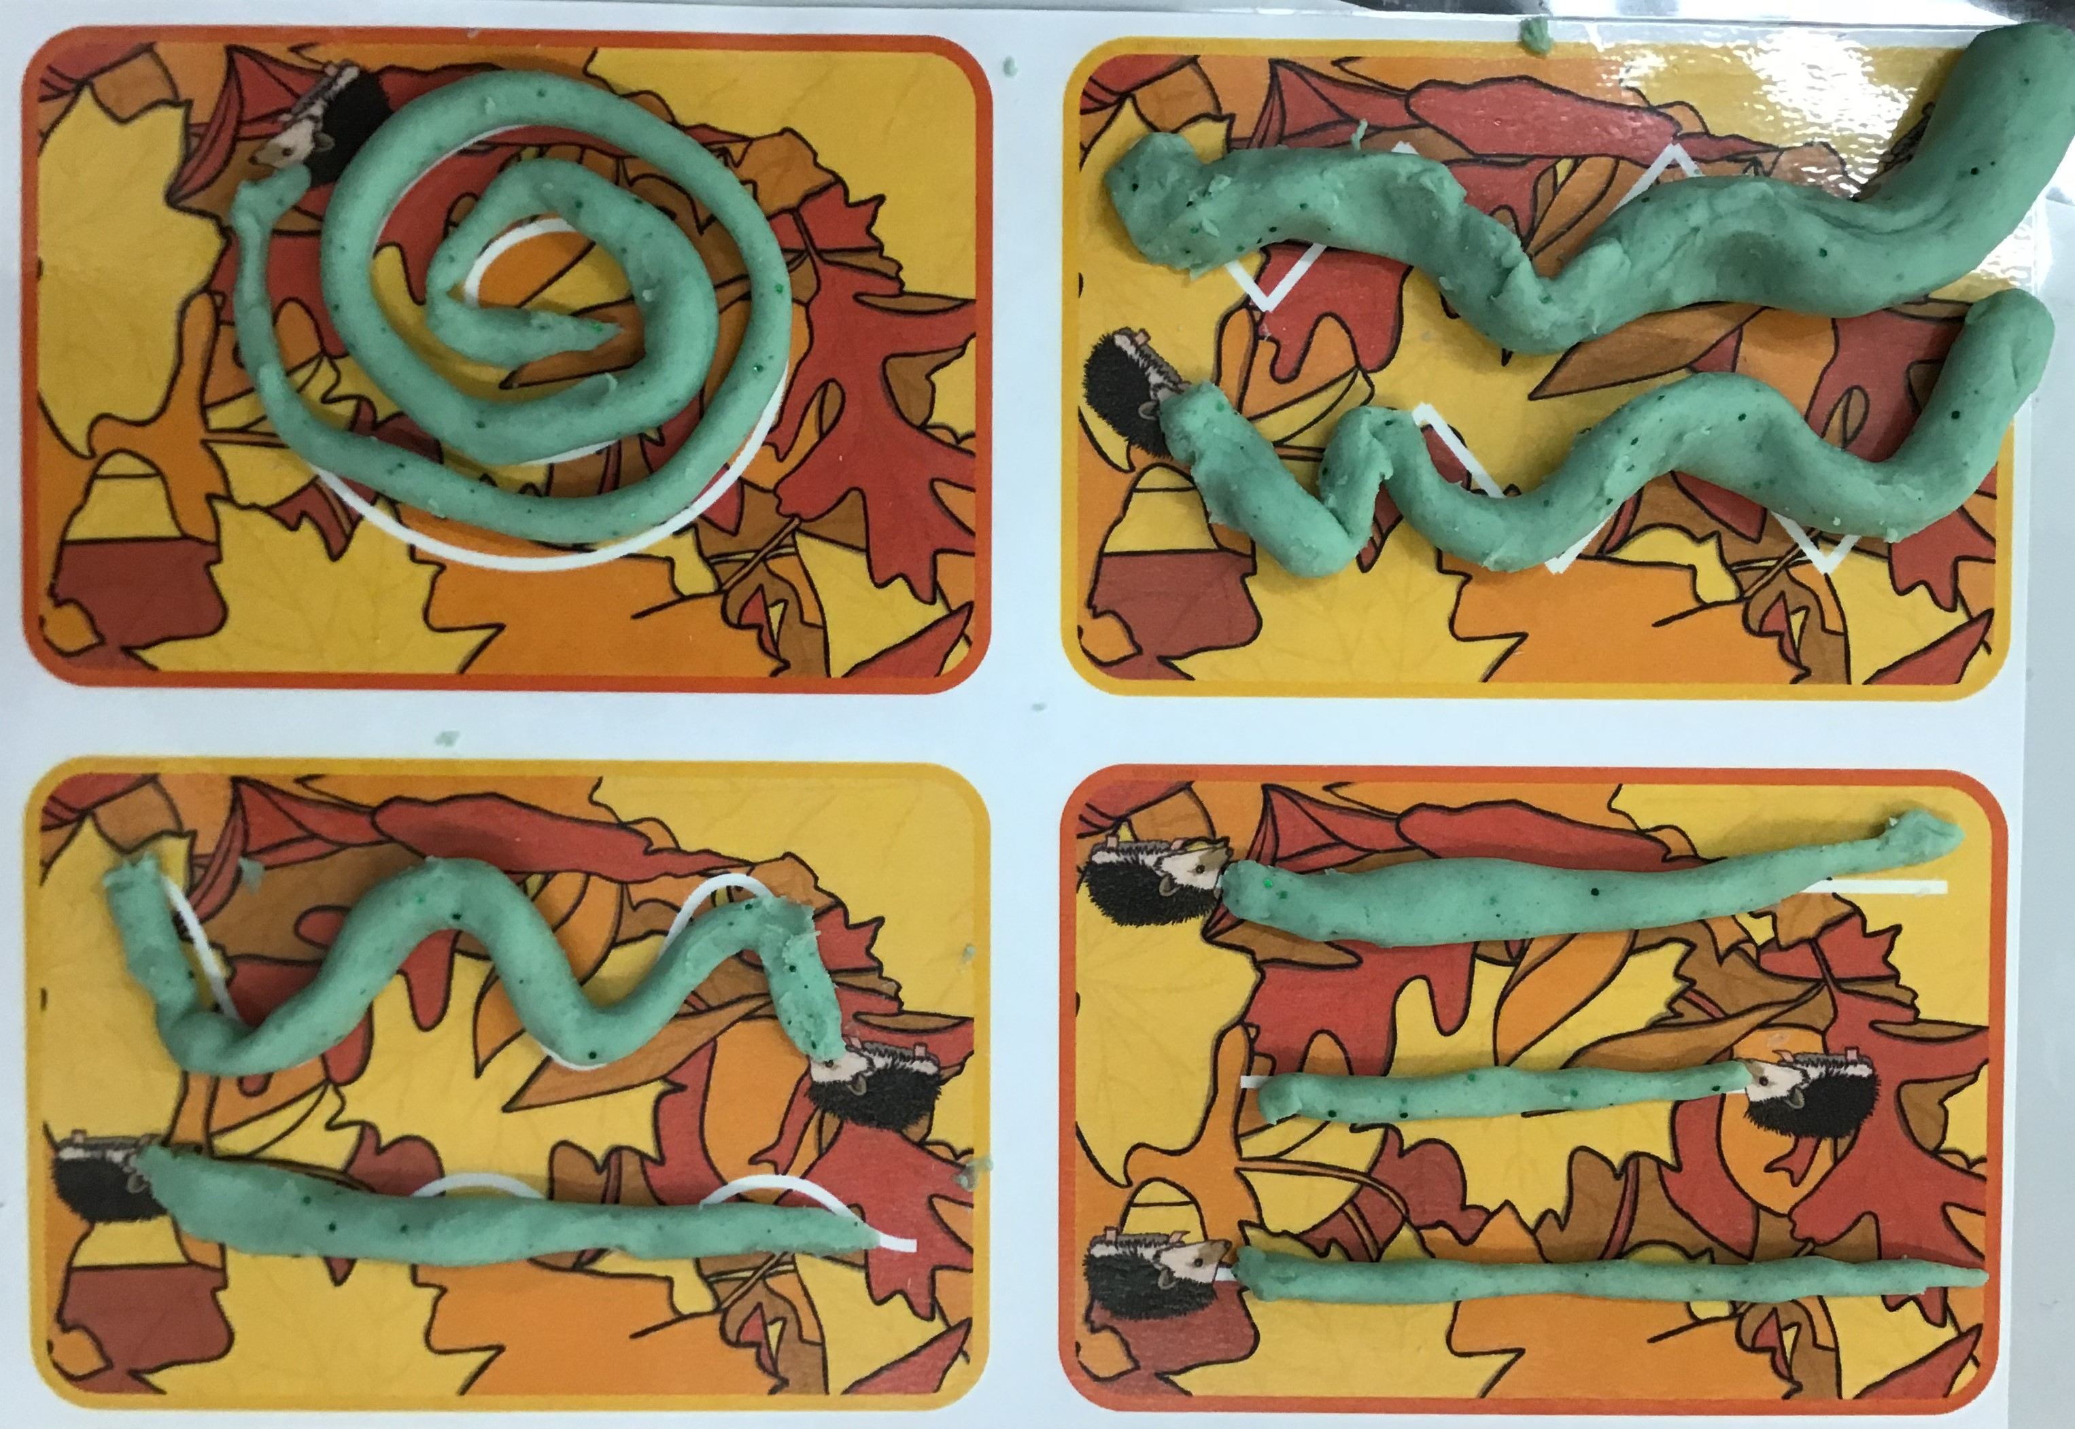
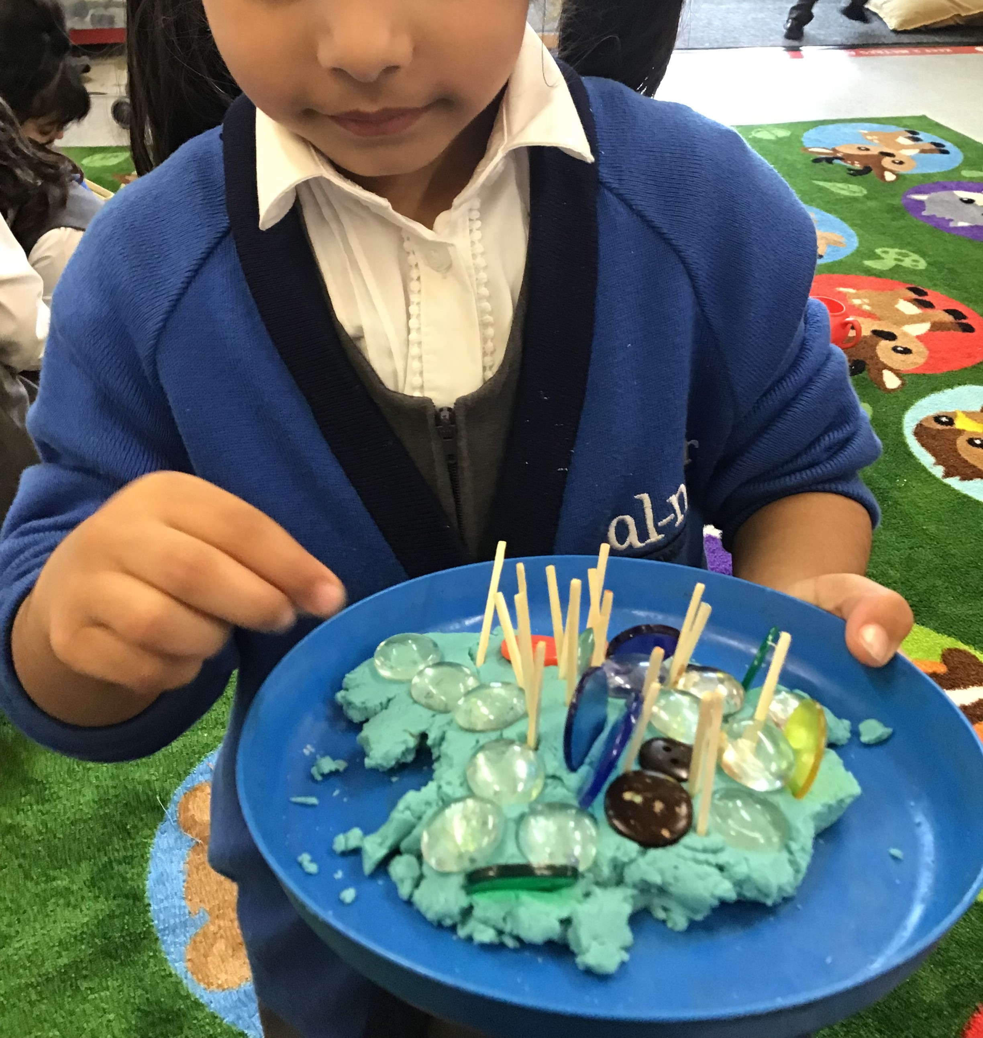
We have been learning to choose our activities and talk about our likes and dislikes

Slide 3
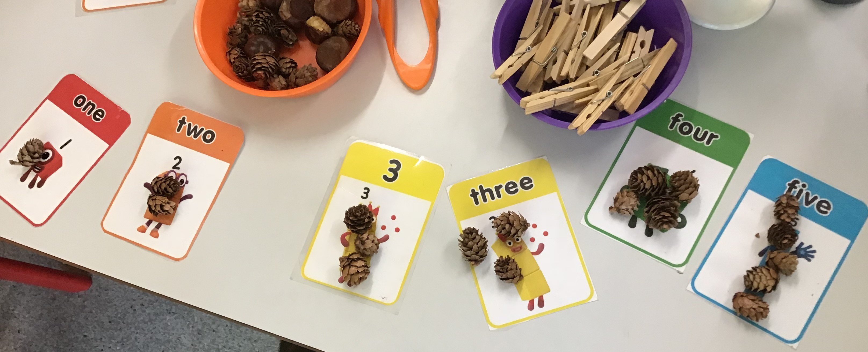
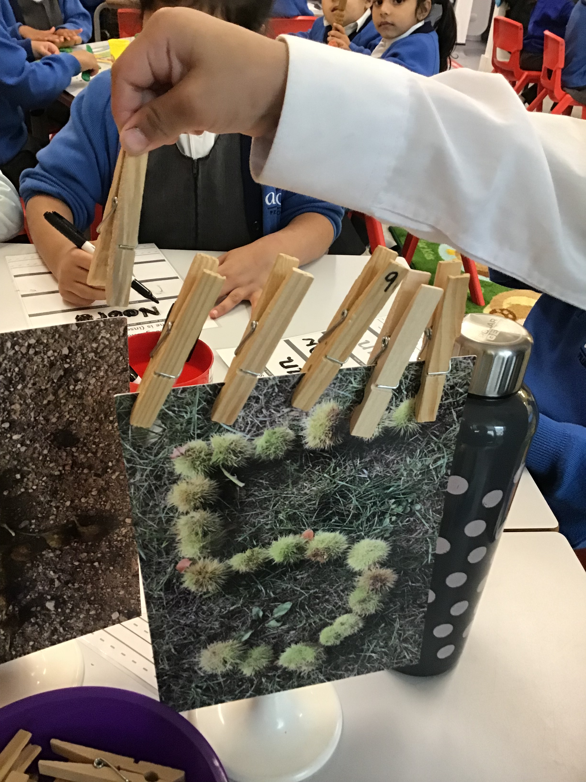
Maths – We have been learning to count objects, recognise, represent and manipulate numbers to 5. We matched groups of objects to the correct numeral and compared two groups of objects. We also found one more and one less than a number within 5

Slide 4
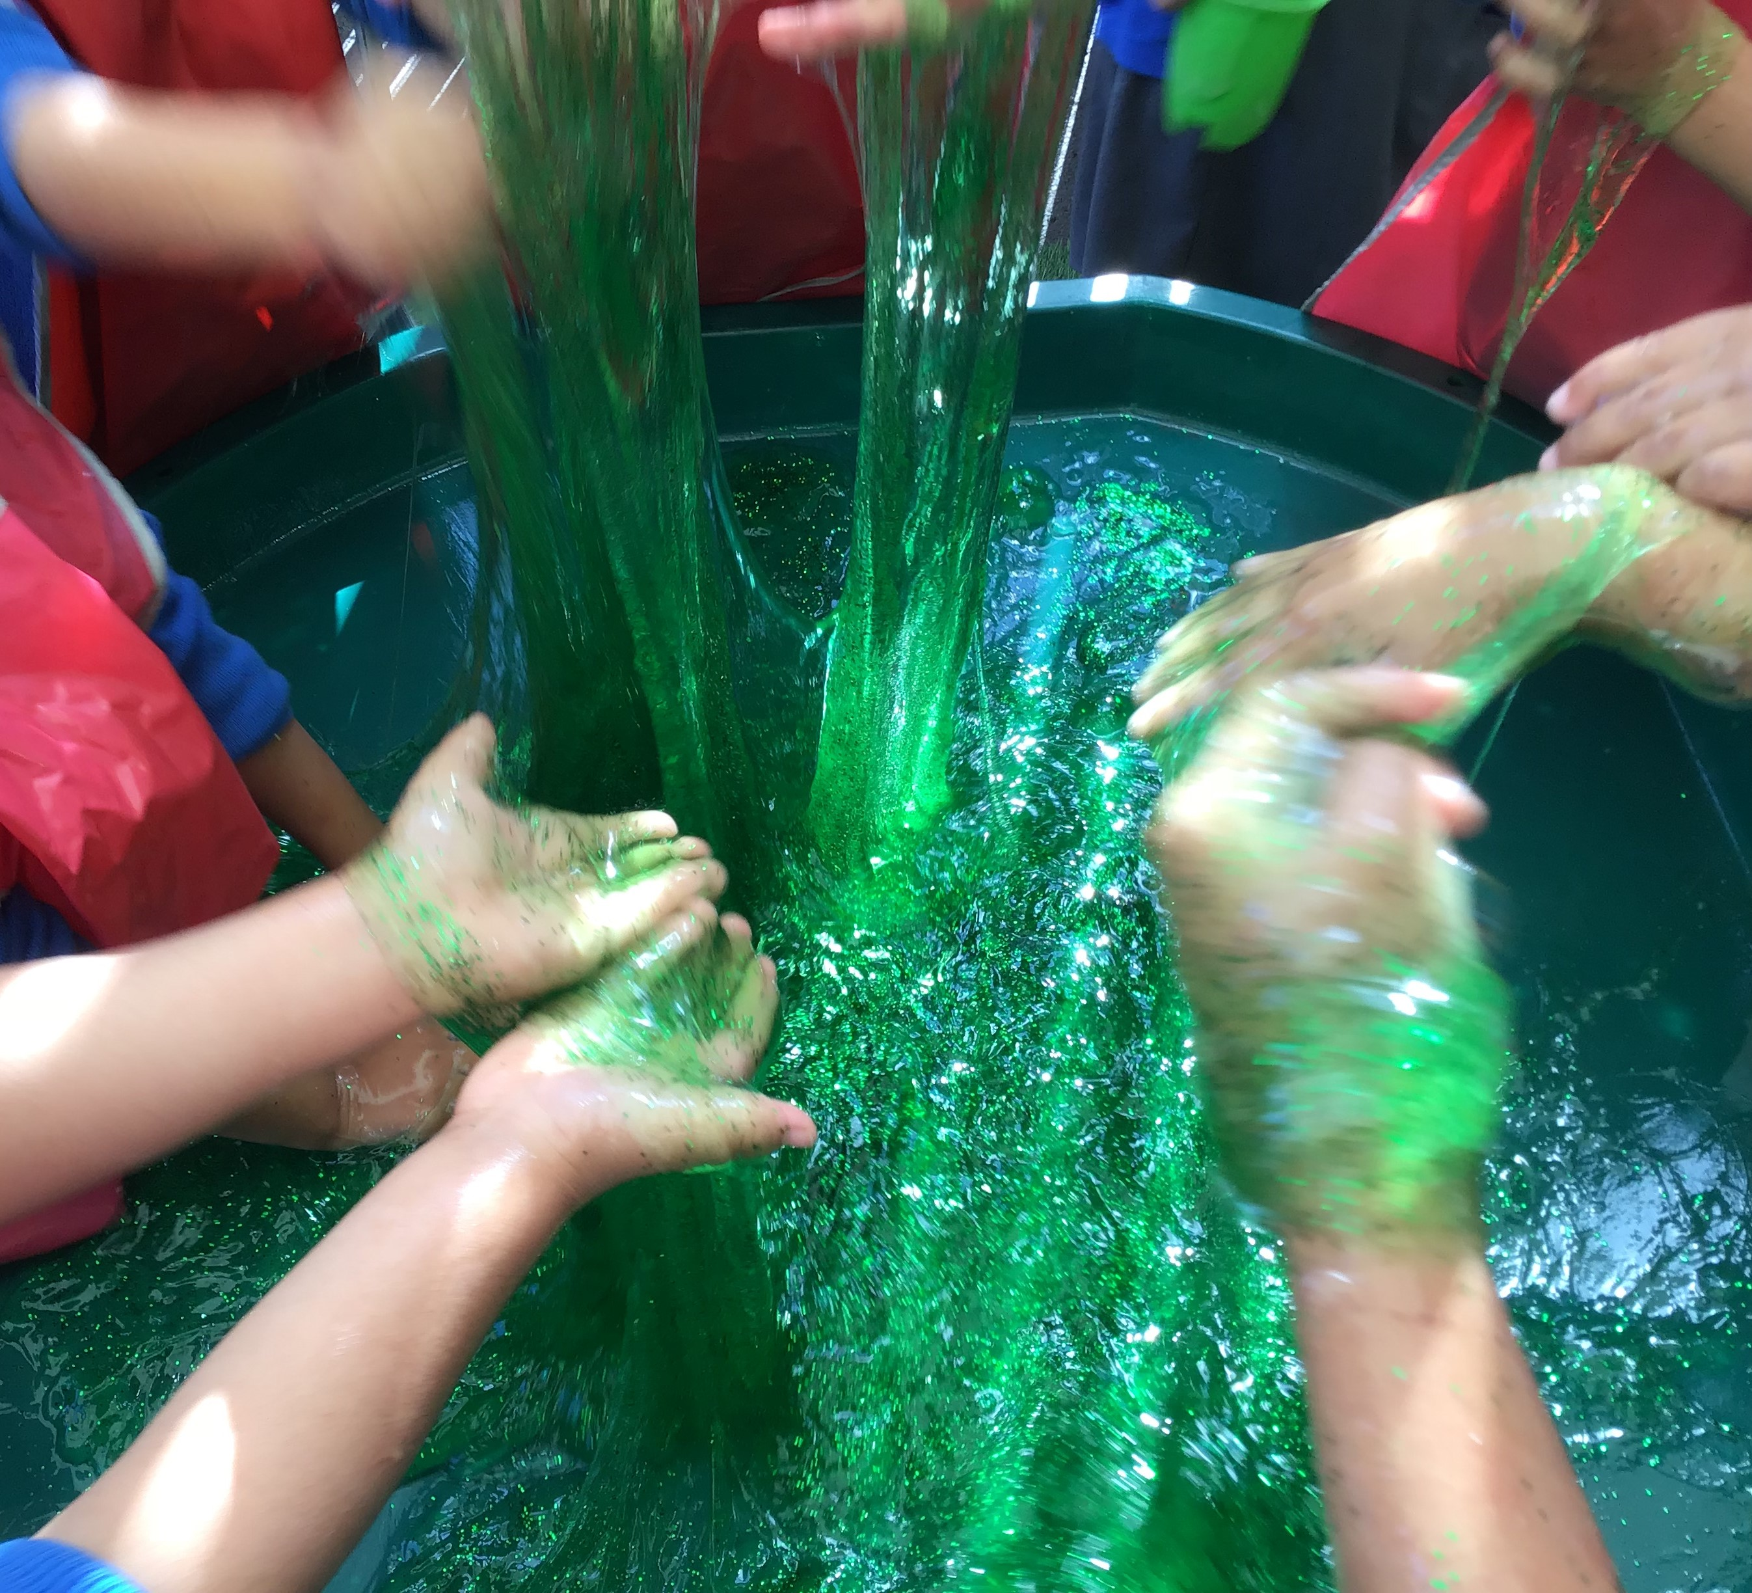
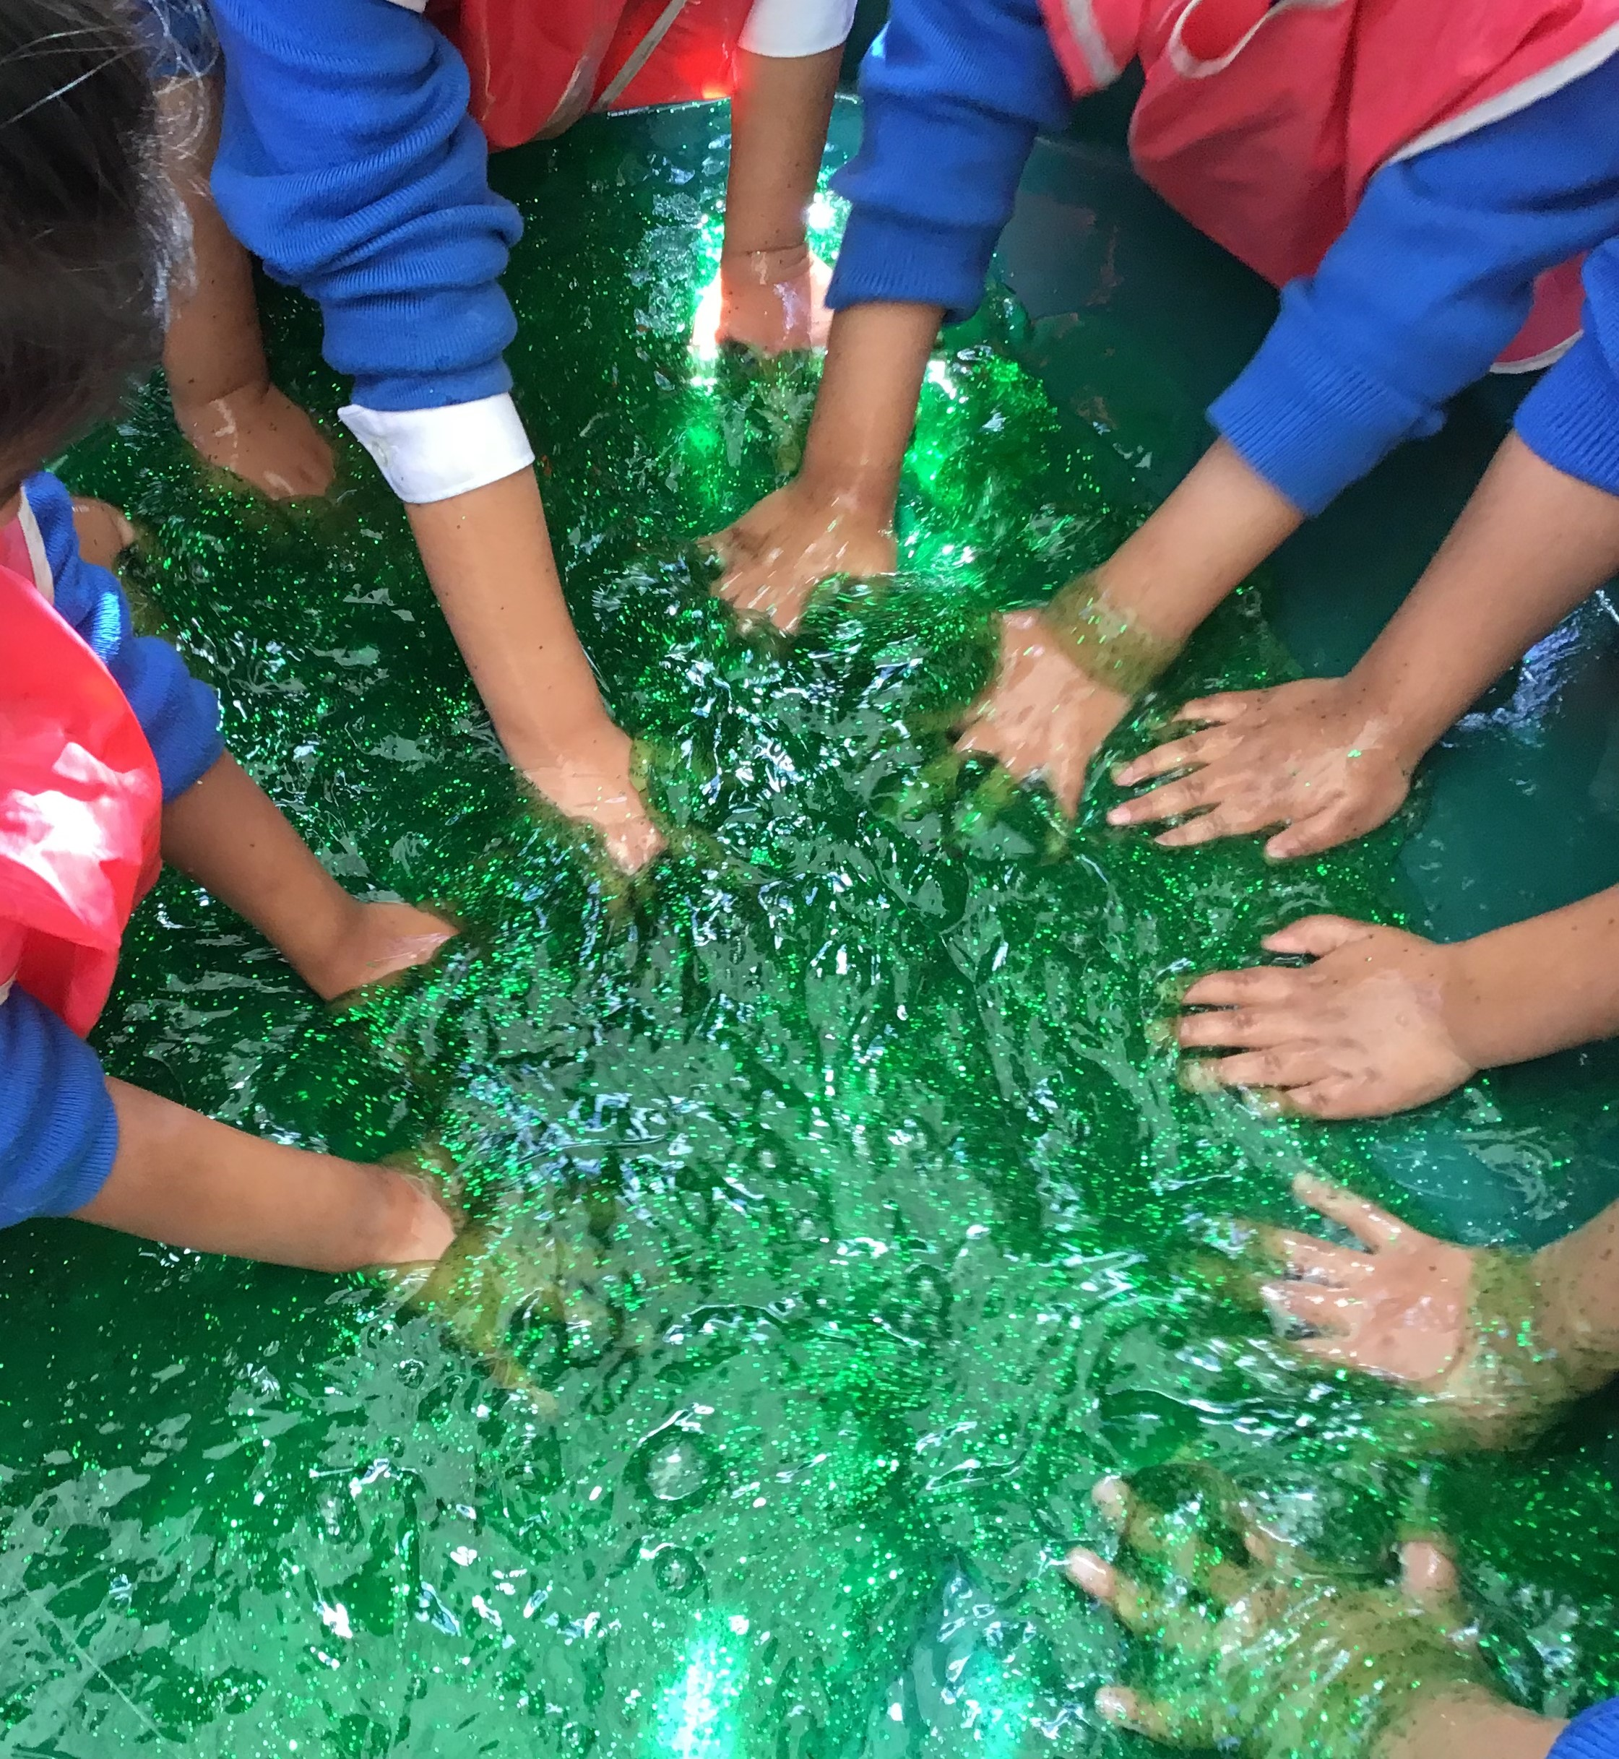
We learned how to keep ourselves clean by playing with messy slime and then learning to wash our hands.

Slide 5
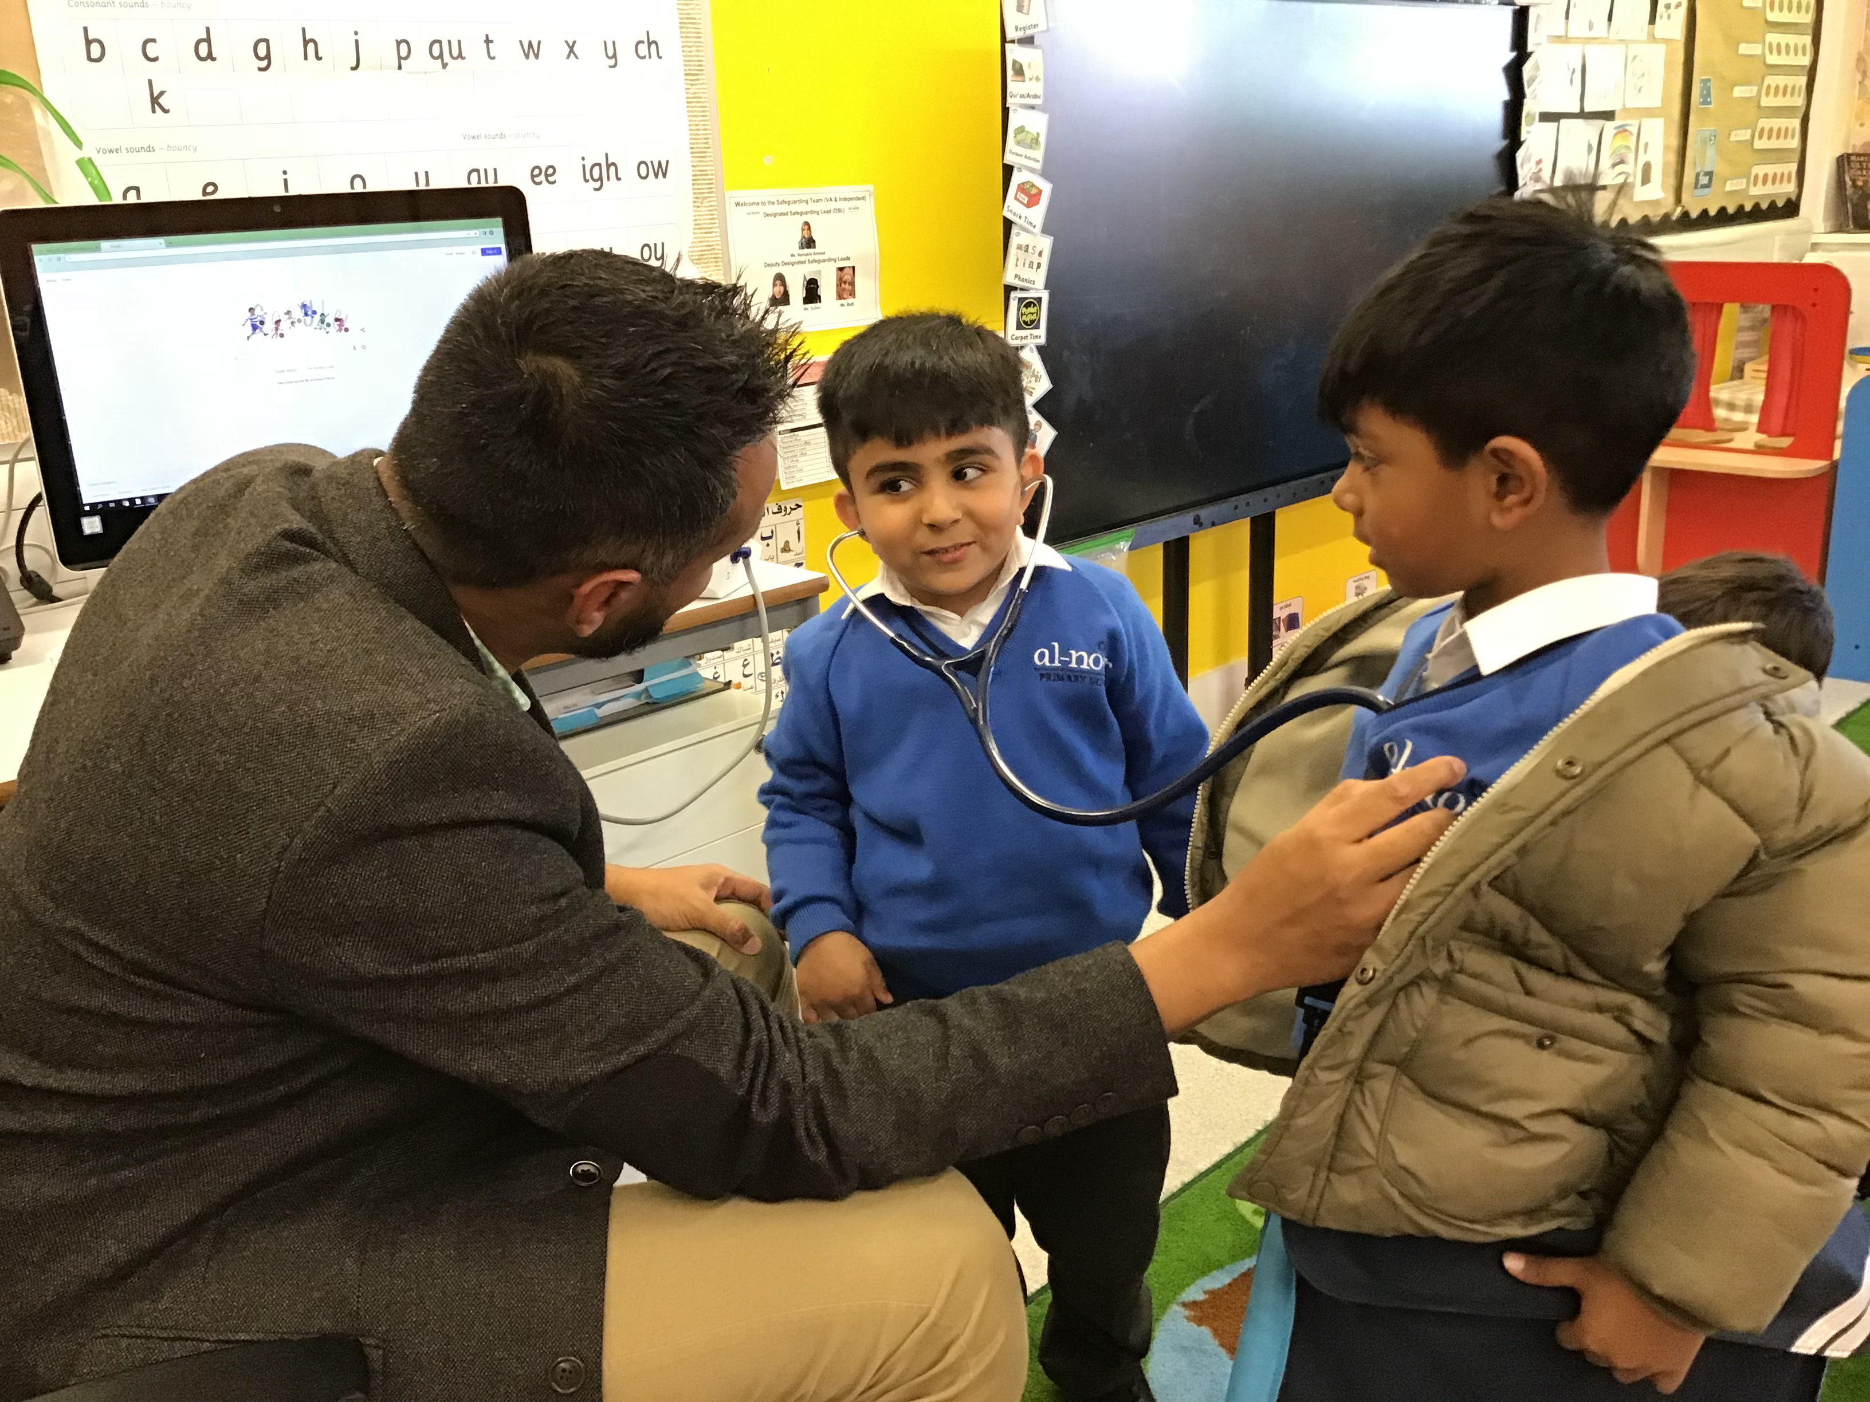
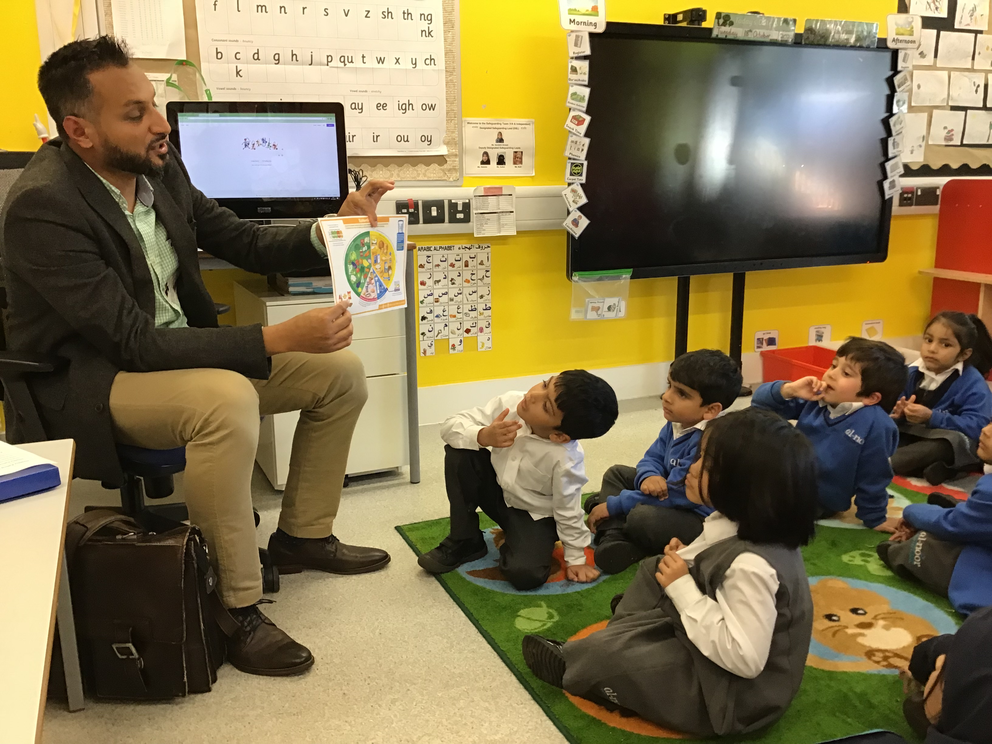
For our drop down day we learned to keep ourselves clean and healthy and learn how Islam teaches us the etiquettes of how to do this.
We had a visit from a doctor who taught us about making healthy choices with our food and exercising. He also demonstrated some equipment he uses in his practice.

